Slide 1
Efficiently Modeling Long Sequences with Structured State Spaces
Albert Gu, Karan Goel, and Christopher Ré
Presented by Woohyun Eum and Erica Lindbeck

Slide 2
Motivation
To address the ‘Long range dependencies’ → Structured State Spaces model [S4 model] =[SSM + HiPPO + Structured Matrices]
Use the State Space Model
Plug in the HiPPO Matrix
Learn the parameters with special algorithm
: Structured Matrices

Slide 3


Motivation
Spectrum of Sequential Data
Signals
Discrete
Continuous
Signals: Data generated from a continuous physics process
Diagram inspired from Albert Gu’s Presentation video

Slide 4
Motivation
Long range dependency challenge
Audio waveforms are sampled at high-rate ex) 16000+ samples per second & Large Dataset Size
Audio signal image

Slide 5
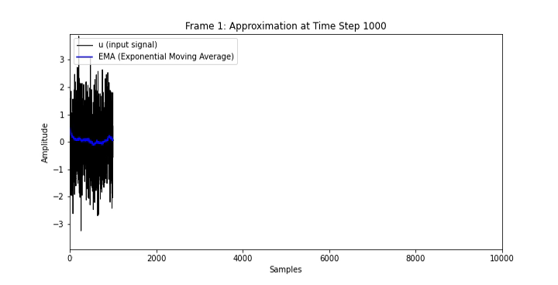
A Simple Example: The Moving Average
EMA :Exponential Moving Average
EMA → Fixed non-learnable feature : Typical preprocessing to handle time series data

Slide 6
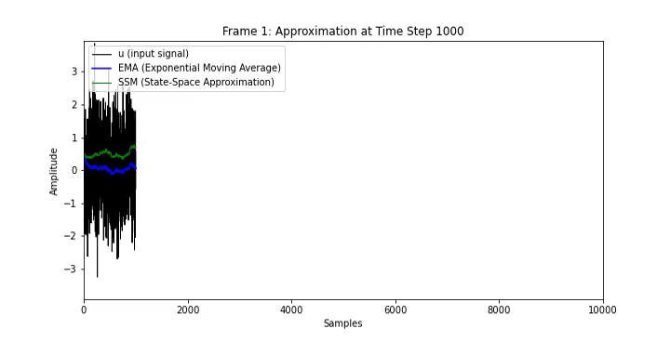
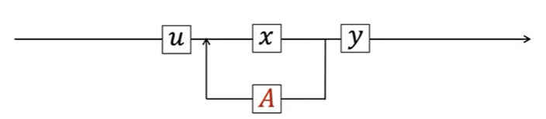

A Simple Example: The Moving Average
State Space Model [SSM]: Representing Dynamic system using Ordinary Differential Equation (ODE).
$$\dot{x}\left(t\right)=A x\left(t\right)+B u\left(t\right)$$
$$y\left(t\right)=C x\left(t\right)+D u(t)$$
∴ By defining State vector, x(t), SSM depicts dynamic system as a linear combinations.
Kalman Filter

Slide 7
A Simple Example: The Moving Average
State Space Model [SSM]: Representing Dynamic system using Ordinary Differential Equation (ODE).
$$\dot{x}\left(t\right)=A x\left(t\right)+B u\left(t\right)$$
$$y\left(t\right)=C x\left(t\right)+D u(t)$$
It is infeasible for model to learn A, B, C, D matrices from data!!!
∴ By defining State vector, x(t), SSM depicts dynamic system as a linear combinations.
Kalman Filter

Slide 8
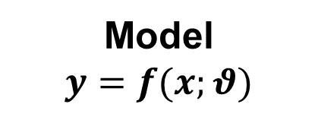


A Simple Example: The Moving Average
Data driven method to approximate EMA signal → Instead of doing manual processing, let’s make our Machine Learning model to learn EMA features automatically from the data
Input $x$
Model
$$y=f(x;θ)$$
output $y$
Kalman Filter

Slide 9
A Simple Example: The Moving Average
Data driven method to approximate EMA signal → Instead of doing manual processing, let’s make our Machine Learning model to learn EMA features automatically from the data
Input $x$
Model
$$y=f(x;θ)$$
output $y$
However, ML model failed to learn EMA features.
∵ EMA has unbounded context
EMA is a weighted average of the entire history of the signal with an exponentially decaying weight.
ML models have finite context window sizes → ML models struggle with long context
Kalman Filter

Slide 10


A Simple Example: The Moving Average
EMA is a simple summary of the entire history of signal
$$\dot{x}=\left(1−α\right) x+ α u$$
“How can we remember context from millions of steps ago?”

Slide 11
A Simple Example: The Moving Average
EMA is a simple summary of the entire history of signal
$$\dot{x}=\left(1−α\right) x+ α u$$
“How can we remember context from millions of steps ago?”
“How can we compress the past data and reconstruct it?”

Slide 12
A Simple Example: The Moving Average
EMA is a simple summary of the entire history of signal
$$\dot{x}=\left(1−α\right) x+ α u$$
“How can we remember context from millions of steps ago?”
“How can we compress the past data and reconstruct it?”
HiPPO: Online memorization
→ “Summary of Entire context Update in constant time”

Slide 13
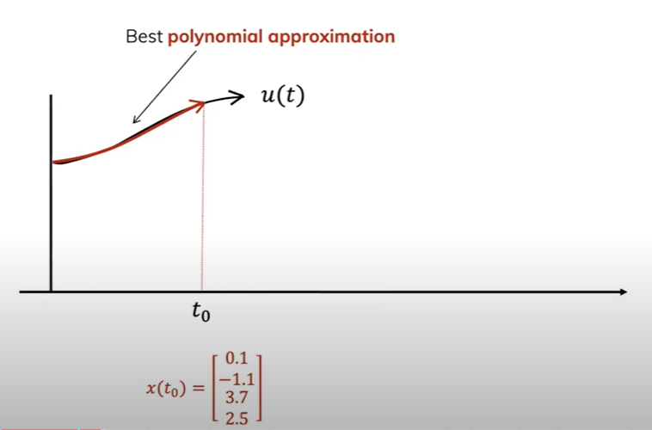
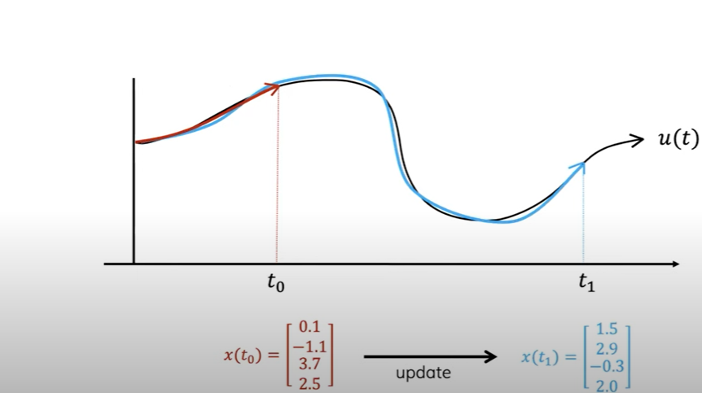
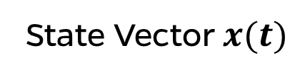

Hippo: Online function reconstruction
Approximate the input signal with compressed representation
→ Project input signals into the space of orthogonal polynomials
Input $u(t)$
Orthogonal Polynomial Projection
State Vector $x(t)$

Slide 14
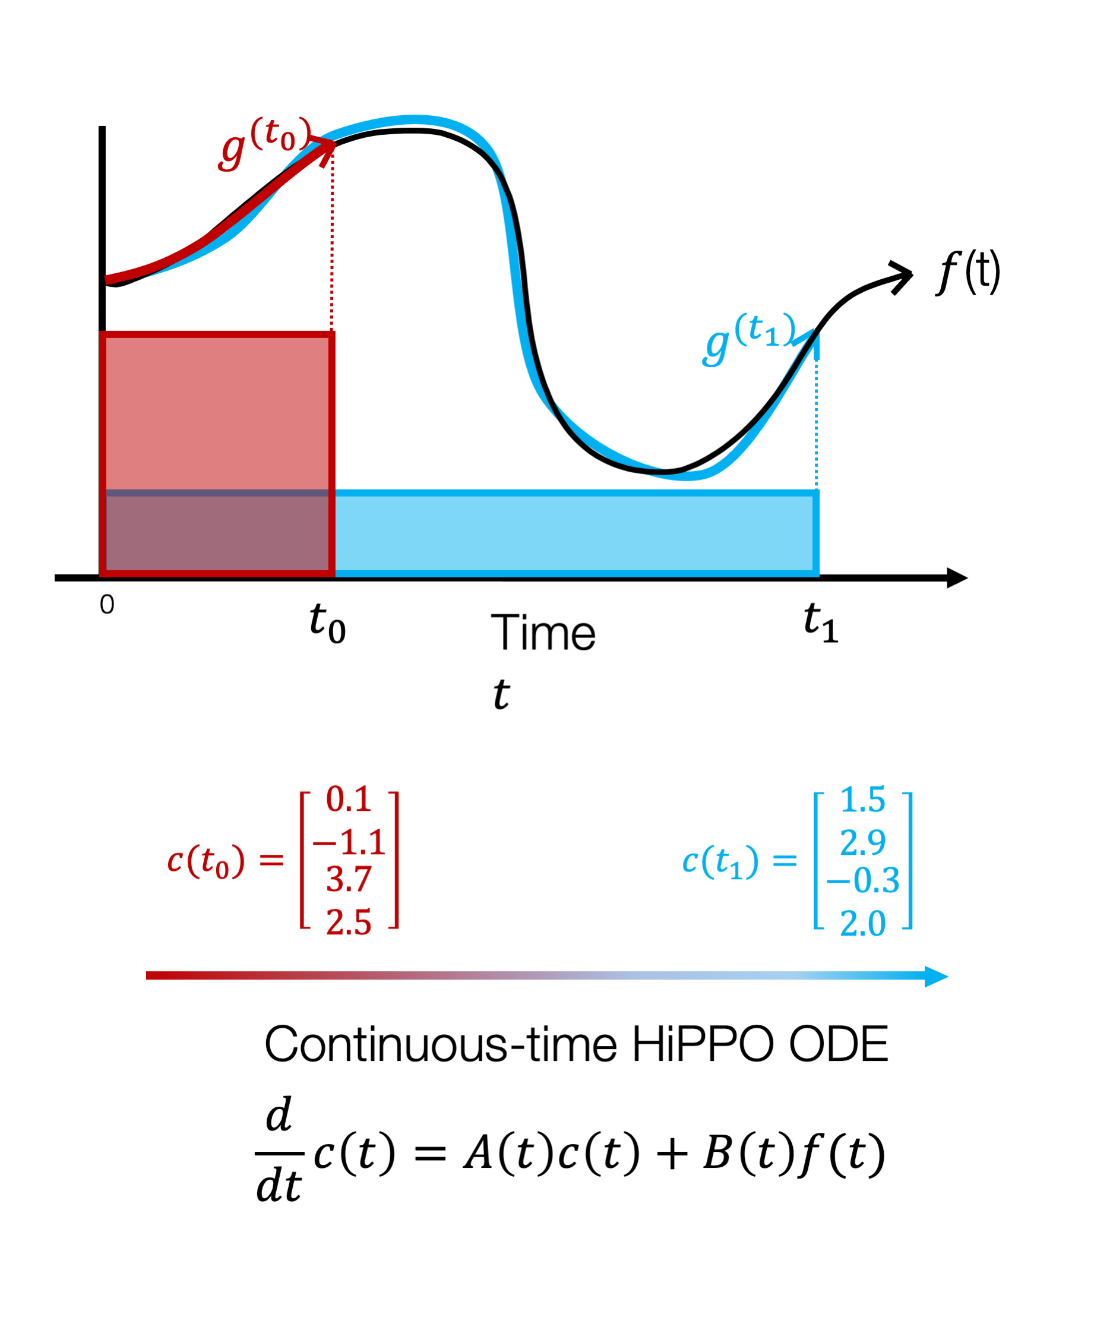

Hippo: Online function reconstruction
Calculate state $x(t)∈ℝ^{N}$that encodes the history of $u(t)$ up to time $t$
Update state $x(t)∈ℝ^{N}$that encodes the history of $u(t)$ up to time $t$

Slide 15
Hippo: Online function reconstruction
Calculate state $x(t)∈ℝ^{N}$that encodes the history of $u(t)$ up to time $t$
Update state $x(t)∈ℝ^{N}$that encodes the history of $u(t)$ up to time $t$
“How can we define the optimal approximation?”
“Find a measure that specifies the quality of approximation”

Slide 16

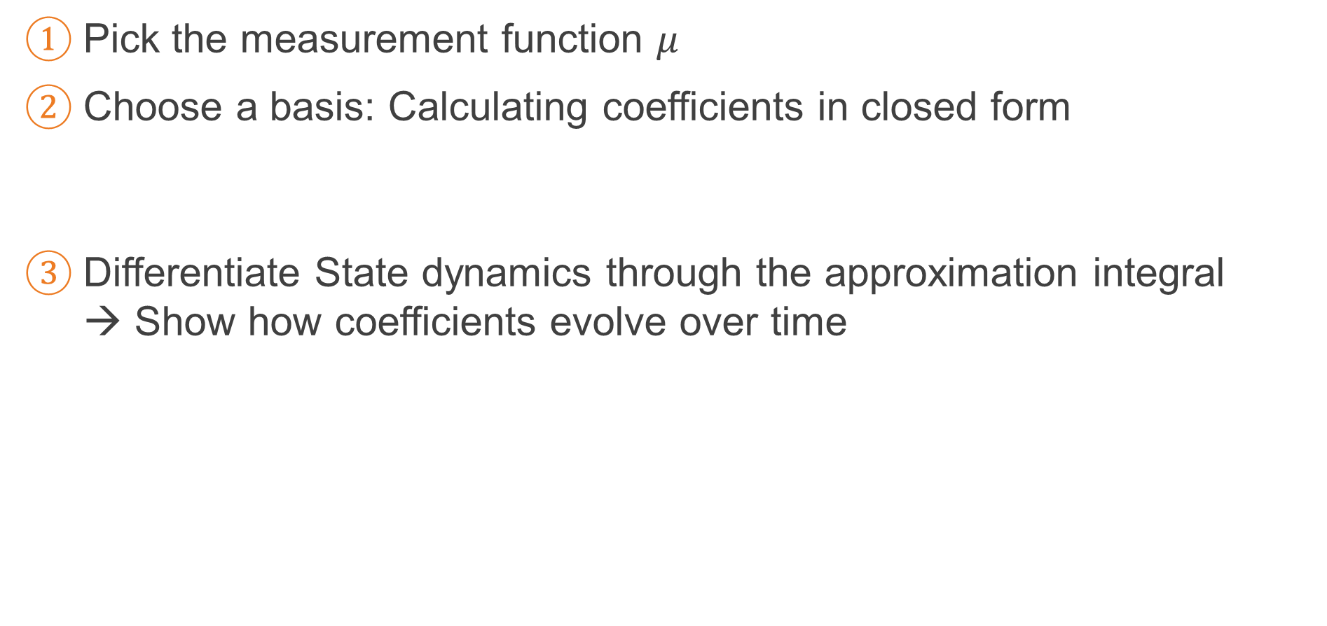

Hippo: Derive the update
Pick the measurement function $μ$
Choose a basis: Calculating coefficients in closed form
Differentiate State dynamics through the approximation integral → Show how coefficients evolve over time
$$x_{i}\left(t\right)=\left\langle u_{≤t},v_{i}^{(t)}\right\rangle =\int_{0}^{t}{u\left(x\right)v_{i}^{t}\left(x\right)μ^{t}\left(x\right)ⅆx}$$
$$\dot{x_{i}}\left(t\right)=\int_{0}^{t}{u\left(x\right)\left(\frac{∂}{∂t}v_{i}^{(t)}\left(x\right)\right)μ_{}^{(t)}\left(x\right)ⅆx}+\int_{0}^{t}{u\left(x\right)v_{i}^{(t)}\left(x\right)\left(\frac{∂}{∂t}μ_{}^{(t)}\left(x\right)\right)ⅆx}$$

Slide 17


Hippo: Derive the update
Pick the measurement function $μ$
Choose a basis: Calculating coefficients in closed form
Differentiate State dynamics through the approximation integral → Show how coefficients evolve over time
$$x_{i}\left(t\right)=\left\langle u_{≤t},v_{i}^{(t)}\right\rangle =\int_{0}^{t}{u\left(x\right)v_{i}^{t}\left(x\right)μ^{t}\left(x\right)ⅆx}$$
$$\dot{x_{i}}\left(t\right)=\int_{0}^{t}{u\left(x\right)\left(\frac{∂}{∂t}v_{i}^{(t)}\left(x\right)\right)μ_{}^{(t)}\left(x\right)ⅆx}+\int_{0}^{t}{u\left(x\right)v_{i}^{(t)}\left(x\right)\left(\frac{∂}{∂t}μ_{}^{(t)}\left(x\right)\right)ⅆx}$$
→ Polynomial approximation makes the differentiate state into the recurrent form
$$=\sum_{j}{v_{j}^{(t)}\left(x\right)}$$

Slide 18

Hippo: Derive the update
Pick the measurement function $μ$
Choose a basis: Calculating coefficients in closed form
Differentiate State dynamics through the approximation integral → Show how coefficients evolve over time
$$x_{i}\left(t\right)=\left\langle u_{≤t},v_{i}^{(t)}\right\rangle =\int_{0}^{t}{u\left(x\right)v_{i}^{t}\left(x\right)μ^{t}\left(x\right)ⅆx}$$
$\dot{x_{i}}\left(t\right)=$ $\sum_{j}{A_{ij}x_{j}^{}\left(t\right)+B_{j}u(t)}$

Slide 19
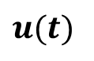



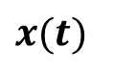
The Hippo Operator
$u(t)$
$x(t)$
HiPPO Operator: $\dot{x}\left(t\right)=Ax\left(t\right)+Bu\left(t\right)$
HiPPO Matrix = Closed form formula → Structured Matrix
HiPPO
Solving differential equation in closed form
$$0 n<k$$
$$n+1 n=k$$
$${\left(2n+1\right)}^{0.5}{\left(2k+1\right)}^{0.5} n>k$$
$$A_{n,k}=$$

Slide 20
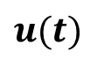

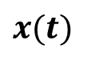
Structured State Space
$u(t)$
$x(t)$
HiPPO Operator: $\dot{x}\left(t\right)=Ax\left(t\right)+Bu\left(t\right)$ → HiPPO maps input signal to a higher dimensional state
It blows up dimension of input feature in Deep Neural Network → Let’s decrease the dimension again
HiPPO

Slide 21
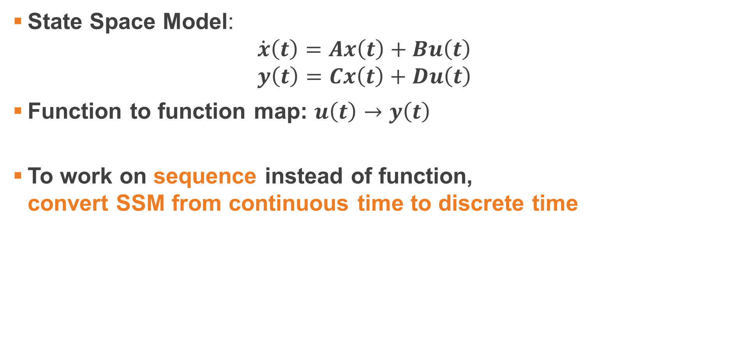
Structured State Space
State Space Model: $\dot{x}\left(t\right)=Ax\left(t\right)+Bu\left(t\right)$ $y\left(t\right)=Cx\left(t\right)+Du\left(t\right)$
Function to function map: $u\left(t\right)→y\left(t\right)$
To work on sequence instead of function, convert SSM from continuous time to discrete time

Slide 22
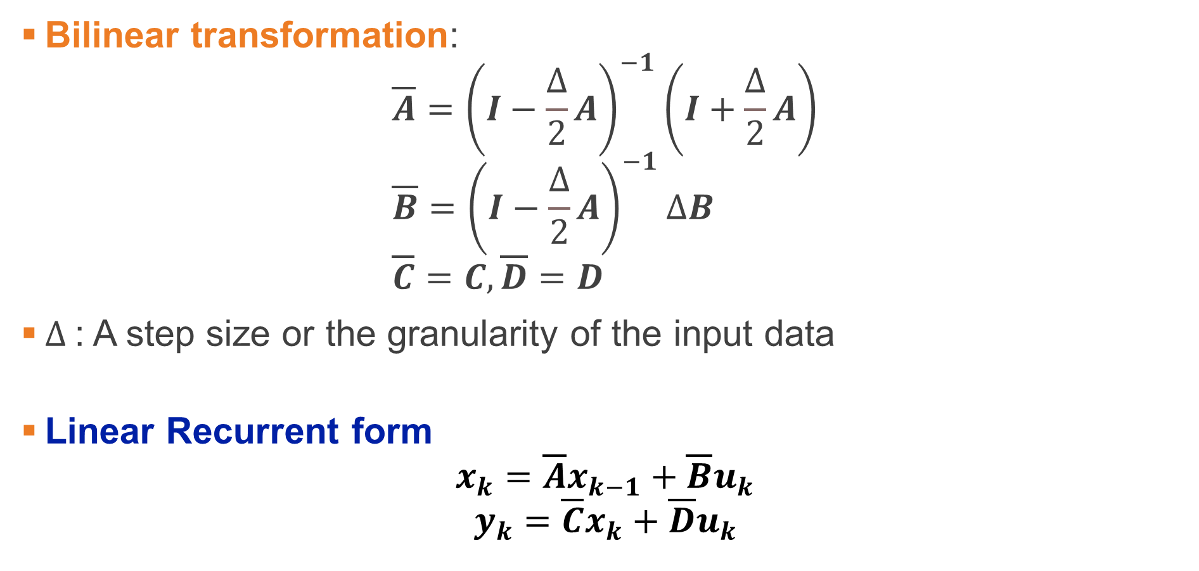
Structured State Space: Discretization
Bilinear transformation: $\overline{A}={\left(I−\frac{Δ}{2}A\right)}^{−1}\left(I+\frac{Δ}{2}A\right)$ $\overline{B}={\left(I−\frac{Δ}{2}A\right)}^{−1}ΔB$ $\overline{C}=C,\overline{D}=D$
$Δ$: A step size or the granularity of the input data
Linear Recurrent form $x_{k}=\overline{A}x_{k−1}+\overline{B}u_{k}$ $y_{k}=\overline{C}x_{k}+\overline{D}u_{k}$

Slide 23
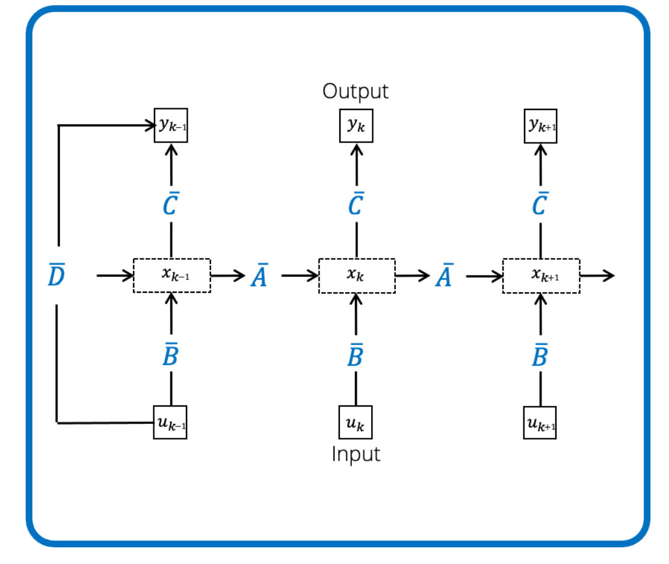

Structured State Space: Discretization
Linear Recurrent form $x_{k}=\overline{A}x_{k−1}+\overline{B}u_{k}$ $y_{k}=\overline{C}x_{k}+\overline{D}u_{k}$

Slide 24

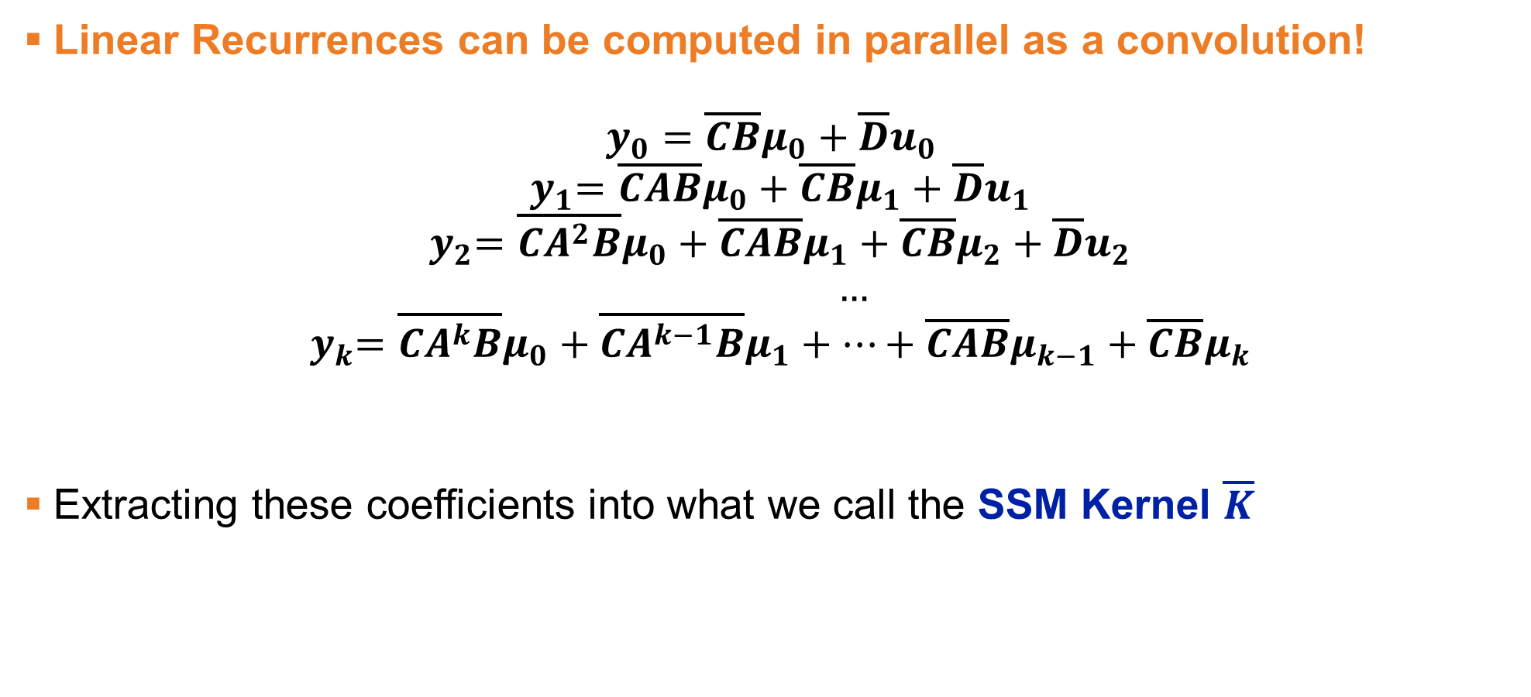
Structured State Space: Computing the State Space with Convolutions
Linear Recurrences can be computed in parallel as a convolution! $y_{0}=\overline{CB}μ_{0}+\overline{D}u_{0}$ ${ y}_{1}=\overline{CAB}μ_{0}+\overline{CB}μ_{1}+\overline{D}u_{1}$ ${ y}_{2}=\overline{CA^{2}B}μ_{0}+\overline{CAB}μ_{1}+\overline{CB}μ_{2}+\overline{D}u_{2}$ $…$ ${ y}_{k}=\overline{CA^{k}B}μ_{0}+\overline{CA^{k−1}B}μ_{1}+…+\overline{CAB}μ_{k−1}+\overline{CB}μ_{k}$
Extracting these coefficients into what we call the SSM Kernel $\overline{K}$
$$\overline{K}={\left(\overline{CA^{i}B}\right)}_{i∈\left[L\right]}=\left(\overline{CB},\overline{CAB}, …,\overline{CA^{L−1}B}\right)$$

Slide 25
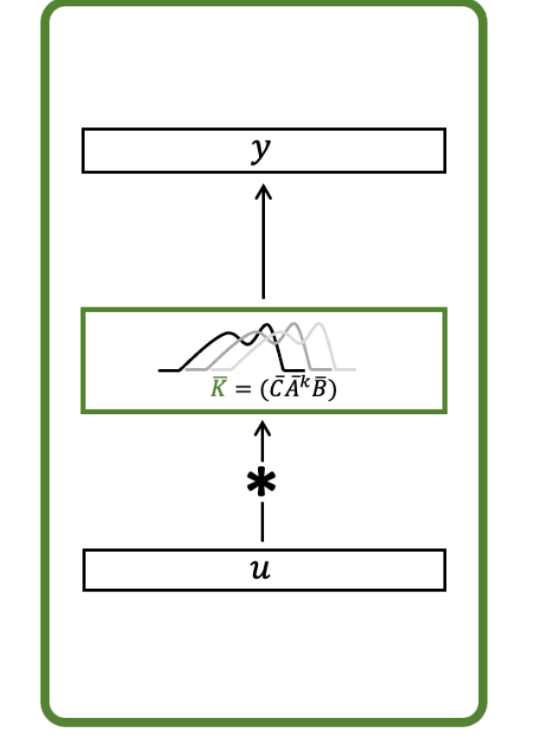


Structured State Space: Computing the State Space with Convolutions
Extracting these coefficients into what we call the SSM Kernel $\overline{K}$
$y=u∗$ $\overline{K}$
$$\overline{K}={\left(\overline{CA^{i}B}\right)}_{i∈\left[L\right]}=\left(\overline{CB},\overline{CAB}, …,\overline{CA^{L−1}B}\right)$$

Slide 26
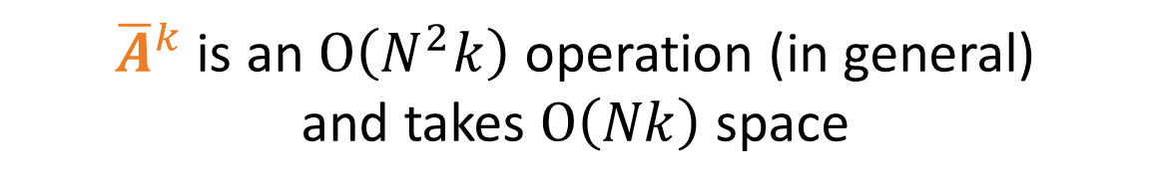

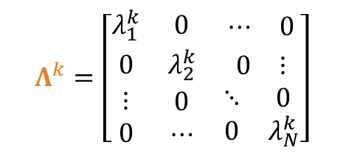
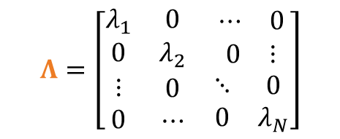
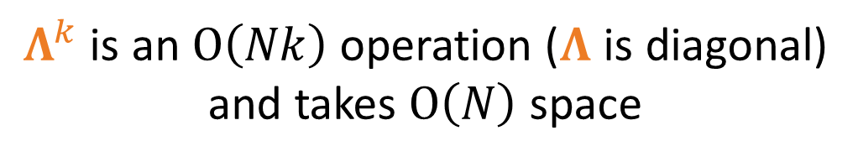
Diagonalization
$$y_{k}=\overline{C}{\overline{A}}^{k}\overline{B}u_{0}+\overline{C}{\overline{A}}^{k−1}\overline{B}u_{1}+⋯+\overline{C}\overline{B}u_{k}$$
${\overline{A}}^{k}$ is an $O\left(N^{2}k\right)$ operation (in general)
and takes $O\left(Nk\right)$ space
$Λ^{k}$ is an $O\left(Nk\right)$ operation ($Λ$ is diagonal)
and takes $O\left(N\right)$ space
$$Λ=\left[\begin{matrix}λ_{1} & 0 & \begin{matrix}⋯ & 0\end{matrix} \\ 0 & λ_{2} & \begin{matrix}0 & ⋮\end{matrix} \\ \begin{matrix}⋮ \\ 0\end{matrix} & \begin{matrix}0 \\ ⋯\end{matrix} & \begin{matrix}⋱ & 0 \\ 0 & λ_{N}\end{matrix}\end{matrix}\right]$$
$$Λ^{k}=\left[\begin{matrix}λ_{1}^{k} & 0 & \begin{matrix}⋯ & 0\end{matrix} \\ 0 & λ_{2}^{k} & \begin{matrix}0 & ⋮\end{matrix} \\ \begin{matrix}⋮ \\ 0\end{matrix} & \begin{matrix}0 \\ ⋯\end{matrix} & \begin{matrix}⋱ & 0 \\ 0 & λ_{N}^{k}\end{matrix}\end{matrix}\right]$$

Slide 27

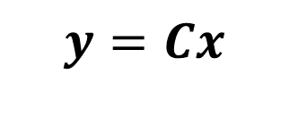
Diagonalization - Change of Variables
$$\frac{δx}{δt}=Ax+Bu$$
$$y=Cx$$

Slide 28

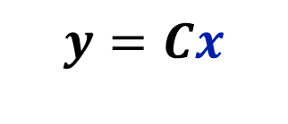

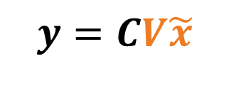

Diagonalization - Change of Variables
$$\frac{δx}{δt}=Ax+Bu$$
$$y=Cx$$
$$x=V\tilde{x}$$
$$V\frac{δx}{δt}=AV\tilde{x}+Bu$$
$$y=CV\tilde{x}$$

Slide 29
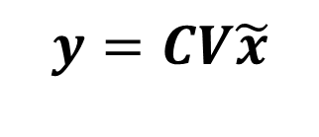
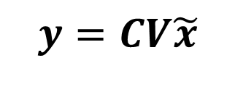
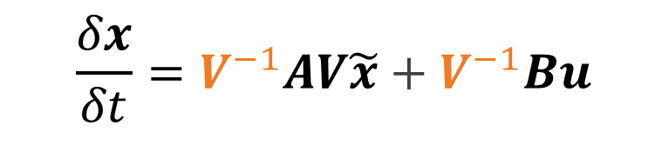
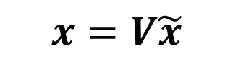
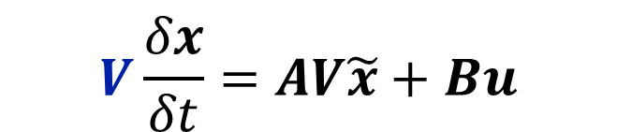
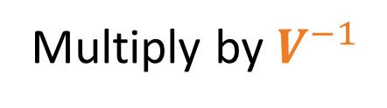
Diagonalization - Change of Variables
$$\frac{δx}{δt}=Ax+Bu$$
$$y=Cx$$
$$x=V\tilde{x}$$
$$V\frac{δx}{δt}=AV\tilde{x}+Bu$$
$$y=CV\tilde{x}$$
Multiply by $V^{−1}$
$$\frac{δx}{δt}=V^{−1}AV\tilde{x}+V^{−1}Bu$$
$$y=CV\tilde{x}$$

Slide 30
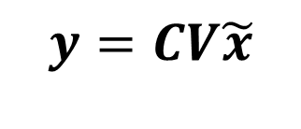




Diagonalization - Change of Variables
$$\tilde{x}=V^{−1}AV\tilde{x}+V^{−1}Bu$$
$$y=CV\tilde{x}$$
Iff $A$ is diagonal, $V^{−1}AV$ is normal
$\overline{A}={\left(I−\frac{∆}{2}A\right)}^{−1}\left(I+\frac{∆}{2}A\right)$ is also diagonal
But not all matrices are normal, and not all $V$ are tractable ☹
(HiPPO in particular!)

Slide 31


Normal Plus Low Rank (NPLR) Formulation
All HiPPO matrices can be expressed as:
$$A=VΛV^{∗}−PQ^{T}$$
where $V∈ℂ^{N×N}$, $VV^{∗}=I$, $Λ$ is diagonal, and $P,Q∈ℝ^{N×r}$

Slide 32

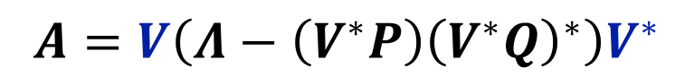





Normal Plus Low Rank (NPLR) Formulation
All HiPPO matrices can be expressed as:
$$A=VΛV^{∗}−PQ^{T}$$
where $V∈ℂ^{N×N}$, $VV^{∗}=I$, $Λ$ is diagonal, and $P,Q∈ℝ^{N×r}$
We can further transform to Diagonal Plus Low Rank (DPLR) form:
$$A=VΛV^{∗}−VV^{∗}PQ^{T}VV^{∗}$$
$$A=VΛV^{∗}−V(V^{∗}PQ^{T}V)V^{∗}$$
$$A=VΛV^{∗}−V(V^{∗}P{\left(V^{∗}Q\right)}^{∗})V^{∗}$$
$$A=V\left(Λ−\left(V^{∗}P\right){\left(V^{∗}Q\right)}^{∗}\right)V^{∗}$$
$$V^{∗}AV=Λ−\left(V^{∗}P\right){\left(V^{∗}Q\right)}^{∗}$$
$$\hat{A}=Λ−\left(V^{∗}P\right){\left(V^{∗}Q\right)}^{∗}$$
$$\hat{A}=Λ−\hat{P}{\hat{Q}}^{∗}$$

Slide 33


Diagonal Plus Low Rank (DPLR) Formulation
$$\hat{A}=Λ−\hat{P}{\hat{Q}}^{∗}$$
$$\overline{A}={\left(I−\frac{∆}{2}\hat{A}\right)}^{−1}\left(I+\frac{∆}{2}\hat{A}\right)$$

Slide 34



Diagonal Plus Low Rank (DPLR) Formulation
$$\hat{A}=Λ−\hat{P}{\hat{Q}}^{∗}$$
$$\overline{A}={\left(I−\frac{∆}{2}\hat{A}\right)}^{−1}\left(I+\frac{∆}{2}\hat{A}\right)$$
$$\overline{A}={\left(I−\frac{∆}{2}\left(Λ−\hat{P}{\hat{Q}}^{∗}\right)\right)}^{−1}\left(I+\frac{∆}{2}\hat{A}\right)$$

Slide 35


Diagonal Plus Low Rank (DPLR) Formulation
$$\hat{A}=Λ−\hat{P}{\hat{Q}}^{∗}$$
$$\overline{A}={\left(I−\frac{∆}{2}\hat{A}\right)}^{−1}\left(I+\frac{∆}{2}\hat{A}\right)$$
$$\overline{A}={\left(I−\frac{∆}{2}\left(Λ−\hat{P}{\hat{Q}}^{∗}\right)\right)}^{−1}\left(I+\frac{∆}{2}\hat{A}\right)$$
$$\overline{A}={\left(\left(I−\frac{∆}{2}Λ\right)+\frac{∆}{2}\hat{P}{\hat{Q}}^{∗}\right)}^{−1}\left(I+\frac{∆}{2}\hat{A}\right)$$

Slide 36

Diagonal Plus Low Rank (DPLR) Formulation
$$\overline{A}={\left(\left(I−\frac{∆}{2}Λ\right)+\frac{∆}{2}\hat{P}{\hat{Q}}^{∗}\right)}^{−1}\left(I+\frac{∆}{2}\hat{A}\right)$$
Diagonal Plus Low Rank

Slide 37






Diagonal Plus Low Rank (DPLR) Formulation
$$\overline{A}={\left(\left(I−\frac{∆}{2}Λ\right)+\frac{∆}{2}\hat{P}{\hat{Q}}^{∗}\right)}^{−1}\left(I+\frac{∆}{2}\hat{A}\right)$$
Diagonal Plus Low Rank
Woodbury Identity: Inverse of DPLR is also DPLR
$\left(D_{1}+L_{1}\right)\left(D_{2}+L_{2}\right)=$ $D_{1}D_{2}+D_{1}L_{2}+L_{1}D_{2}+L_{1}L_{2}$
$O\left(N\right)$
$O\left(Nr\right)$
$O\left(Nr\right)$
$O\left(Nr\right)$
Product is also DPLR
$\sim O\left(N\right)$ !

Slide 38

Diagonal Plus Low Rank (DPLR) Formulation (Recurrent)
$$x_{k}=\overline{A}x_{k−1}+\overline{B}u_{k}$$

Slide 39



Diagonal Plus Low Rank (DPLR) Formulation (Recurrent)
$$x_{k}=\overline{A}x_{k−1}+\overline{B}u_{k}$$
$$\overline{B}=\left(I−\frac{∆}{2}\hat{A}\right)B$$
$$x_{k}=\overline{A}x_{k−1}+\left(I−\frac{∆}{2}\hat{A}\right)Bu_{k}$$

Slide 40





Diagonal Plus Low Rank (DPLR) Formulation (Recurrent)
$$x_{k}=\overline{A}x_{k−1}+\overline{B}u_{k}$$
$$\overline{B}=\left(I−\frac{∆}{2}\hat{A}\right)B$$
$$x_{k}=\overline{A}x_{k−1}+\left(I−\frac{∆}{2}\hat{A}\right)Bu_{k}$$
$O\left(N\right)$
$O\left(NH_{u}\right)$
$O\left(N\right)$

Slide 41






Diagonal Plus Low Rank (DPLR) Formulation (Recurrent)
$$x_{k}=\overline{A}x_{k−1}+\overline{B}u_{k}$$
$$\overline{B}=\left(I−\frac{∆}{2}\hat{A}\right)B$$
$$x_{k}=\overline{A}x_{k−1}+\left(I−\frac{∆}{2}\hat{A}\right)Bu_{k}$$
$O\left(N\right)$
$O\left(NH_{u}\right)$
$O\left(N\right)$
$$y_{k}=\overline{C}x_{k}$$
$$\overline{C}=C$$
$O\left(NH_{y}\right)$

Slide 42



Diagonal Plus Low Rank (DPLR) Formulation (Recurrent)
$$x_{k}=\overline{A}x_{k−1}+\overline{B}u_{k}$$
$$\overline{B}=\left(I−\frac{∆}{2}\hat{A}\right)B$$
$$x_{k}=\overline{A}x_{k−1}+\left(I−\frac{∆}{2}\hat{A}\right)Bu_{k}$$
$O\left(N\right)$
$O\left(NH_{u}\right)$
$O\left(N\right)$
$"O\left(N\right)"$
$$y_{k}=\overline{C}x_{k}$$
$$\overline{C}=C$$
$O\left(NH_{y}\right)$

Slide 43


Diagonal Plus Low Rank (DPLR) Formulation (Convolved)
$$y_{k}={\overline{C}}^{∗}{\overline{A}}^{k}\overline{B}u_{0}+{\overline{C}}^{∗}{\overline{A}}^{k−1}\overline{B}u_{1}+⋯+{\overline{C}}^{∗}\overline{B}u_{k}$$
For $k=1,⋯,L$

Slide 44


Diagonal Plus Low Rank (DPLR) Formulation (Convolved)
$$y_{k}={\overline{C}}^{∗}{\overline{A}}^{k}\overline{B}u_{0}+{\overline{C}}^{∗}{\overline{A}}^{k−1}\overline{B}u_{1}+⋯+{\overline{C}}^{∗}\overline{B}u_{k}$$
For $k=1,⋯,L$
$$y=K_{L}∗u$$
$$K_{L}=\left({\overline{C}}^{∗}\overline{B},{\overline{C}}^{∗}\overline{A}\overline{B},⋯,{\overline{C}}^{∗}{\overline{A}}^{L−2}\overline{B},{\overline{C}}^{∗}{\overline{A}}^{L−1}\overline{B}\right)∈ℝ^{L}$$

Slide 45


Diagonal Plus Low Rank (DPLR) Formulation (Convolved)
$$y_{k}={\overline{C}}^{∗}{\overline{A}}^{k}\overline{B}u_{0}+{\overline{C}}^{∗}{\overline{A}}^{k−1}\overline{B}u_{1}+⋯+{\overline{C}}^{∗}\overline{B}u_{k}$$
For $k=1,⋯,L$
$$y=K_{L}∗u$$
$$K_{L}=\left({\overline{C}}^{∗}\overline{B},{\overline{C}}^{∗}\overline{A}\overline{B},⋯,{\overline{C}}^{∗}{\overline{A}}^{L−2}\overline{B},{\overline{C}}^{∗}{\overline{A}}^{L−1}\overline{B}\right)∈ℝ^{L}$$
${\overline{A}}^{L}$ is an $O\left(NL\right)$ operation again ☹

Slide 46

Diagonal Plus Low Rank (DPLR) Formulation (Convolved)
$$y_{k}={\overline{C}}^{∗}{\overline{A}}^{k}\overline{B}u_{0}+{\overline{C}}^{∗}{\overline{A}}^{k−1}\overline{B}u_{1}+⋯+{\overline{C}}^{∗}\overline{B}u_{k}$$
For $k=1,⋯,L$
$$y=K_{L}∗u$$
$$K_{L}=\left({\overline{C}}^{∗}\overline{B},{\overline{C}}^{∗}\overline{A}\overline{B},⋯,{\overline{C}}^{∗}{\overline{A}}^{L−2}\overline{B},{\overline{C}}^{∗}{\overline{A}}^{L−1}\overline{B}\right)∈ℝ^{L}$$
${\overline{A}}^{L}$ is an $O\left(N^{2}L\right)$ operation again ☹
Workaround: Frequency domain!
FFT is $O\left(L\log{L}\right)$

Slide 47

Diagonal Plus Low Rank (DPLR) Formulation (Convolved)
$$X_{k}=\sum_{n=0}^{N−1}{x_{n}}e^{{−2πjn(k}/{L)}}$$
Discrete Fourier Transform:

Slide 48


Diagonal Plus Low Rank (DPLR) Formulation (Convolved)
$$X_{k}=\sum_{n=0}^{N−1}{x_{n}}e^{{−2πjn(k}/{L)}}$$
Discrete Fourier Transform:
$$K_{L}=\left({\overline{C}}^{∗}\overline{B},{\overline{C}}^{∗}\overline{A}\overline{B},⋯,{\overline{C}}^{∗}{\overline{A}}^{L−2}\overline{B},{\overline{C}}^{∗}{\overline{A}}^{L−1}\overline{B}\right)∈ℝ^{L}$$

Slide 49



Diagonal Plus Low Rank (DPLR) Formulation (Convolved)
$$X_{k}=\sum_{n=0}^{N−1}{x_{n}}e^{{−2πjn(k}/{L)}}$$
Discrete Fourier Transform:
$$K_{L}=\left({\overline{C}}^{∗}\overline{B},{\overline{C}}^{∗}\overline{A}\overline{B},⋯,{\overline{C}}^{∗}{\overline{A}}^{L−2}\overline{B},{\overline{C}}^{∗}{\overline{A}}^{L−1}\overline{B}\right)∈ℝ^{L}$$
$${\hat{K}}_{Ll}=\sum_{i=0}^{L−1}{{\overline{C}}^{∗}{\overline{A}}^{i}\overline{B}}e^{{−2πji(l}/{L)}}$$

Slide 50


Diagonal Plus Low Rank (DPLR) Formulation (Convolved)
$$X_{k}=\sum_{n=0}^{N−1}{x_{n}}e^{{−2πjn(k}/{L)}}$$
Discrete Fourier Transform:
$$K_{L}=\left({\overline{C}}^{∗}\overline{B},{\overline{C}}^{∗}\overline{A}\overline{B},⋯,{\overline{C}}^{∗}{\overline{A}}^{L−2}\overline{B},{\overline{C}}^{∗}{\overline{A}}^{L−1}\overline{B}\right)∈ℝ^{L}$$
$${\hat{K}}_{Ll}=\sum_{i=0}^{L−1}{{\overline{C}}^{∗}{\overline{A}}^{i}\overline{B}}e^{{−2πji(l}/{L)}}$$
$${\hat{K}}_{Ll}=\sum_{i=0}^{L−1}{{\overline{C}}^{∗}{\overline{A}}^{i}\overline{B}}z_{l}^{i}$$
$$z_{l}=e^{{−2πj(l}/{L)}}$$

Slide 51


Diagonal Plus Low Rank (DPLR) Formulation (Convolved)
$$K=\left({\overline{C}}^{∗}\overline{B},{\overline{C}}^{∗}\overline{A}\overline{B},⋯ \right)$$
$$K_{L}=\left({\overline{C}}^{∗}\overline{B},{\overline{C}}^{∗}\overline{A}\overline{B},⋯,{\overline{C}}^{∗}{\overline{A}}^{L−2}\overline{B},{\overline{C}}^{∗}{\overline{A}}^{L−1}\overline{B}\right)∈ℝ^{L}$$

Slide 52


Diagonal Plus Low Rank (DPLR) Formulation (Convolved)
$$K=\left({\overline{C}}^{∗}\overline{B},{\overline{C}}^{∗}\overline{A}\overline{B},⋯ \right)$$
$$K_{L}=\left({\overline{C}}^{∗}\overline{B},{\overline{C}}^{∗}\overline{A}\overline{B},⋯,{\overline{C}}^{∗}{\overline{A}}^{L−2}\overline{B},{\overline{C}}^{∗}{\overline{A}}^{L−1}\overline{B}\right)∈ℝ^{L}$$
$$\hat{K}=\sum_{i=0}^{∞}{{\overline{C}}^{∗}{\overline{A}}^{i}\overline{B}z^{i}}={\overline{C}}^{∗}{\left(I−\overline{A}z\right)}^{−1}\overline{B}$$
This is analogous to $\sum_{i=0}^{∞}{p^{i}}={\left(1−p\right)}^{−1}$

Slide 53


Diagonal Plus Low Rank (DPLR) Formulation (Convolved)
$$K=\left({\overline{C}}^{∗}\overline{B},{\overline{C}}^{∗}\overline{A}\overline{B},⋯ \right)$$
$$K_{L}=\left({\overline{C}}^{∗}\overline{B},{\overline{C}}^{∗}\overline{A}\overline{B},⋯,{\overline{C}}^{∗}{\overline{A}}^{L−2}\overline{B},{\overline{C}}^{∗}{\overline{A}}^{L−1}\overline{B}\right)∈ℝ^{L}$$
$$\hat{K}=\sum_{i=0}^{∞}{{\overline{C}}^{∗}{\overline{A}}^{i}\overline{B}z^{i}}={\overline{C}}^{∗}{\left(I−\overline{A}z\right)}^{−1}\overline{B}$$
This is analogous to $\sum_{i=0}^{∞}{p^{i}}={\left(1−p\right)}^{−1}$
$${\hat{K}}_{L}=\sum_{i=0}^{L−1}{{\overline{C}}^{∗}{\overline{A}}^{i}\overline{B}z^{i}}={\overline{C}}^{∗}{\left(I−{\overline{A}}^{L}z^{L}\right)\left(I−\overline{A}z\right)}^{−1}\overline{B}$$
This is analogous to $\sum_{i=0}^{L}{p^{i}}=\sum_{i=0}^{∞}{p^{i}}−\sum_{i=L−1}^{∞}{p^{i}}=\sum_{i=0}^{∞}{p^{i}}−p^{L}\sum_{i=0}^{∞}{p^{i}}=\left(1−p^{L}\right)\sum_{i=0}^{∞}{p^{i}}=\left(1−p^{L}\right){\left(1−p\right)}^{−1}$

Slide 54

Diagonal Plus Low Rank (DPLR) Formulation (Convolved)
$${\hat{K}}_{L}=\sum_{i=0}^{L−1}{{\overline{C}}^{∗}{\overline{A}}^{i}\overline{B}z^{i}}={\overline{C}}^{∗}{\left(I−{\overline{A}}^{L}z^{L}\right)\left(I−\overline{A}z\right)}^{−1}\overline{B}$$

Slide 55



Diagonal Plus Low Rank (DPLR) Formulation (Convolved)
$${\hat{K}}_{L}=\sum_{i=0}^{L−1}{{\overline{C}}^{∗}{\overline{A}}^{i}\overline{B}z^{i}}={\overline{C}}^{∗}{\left(I−{\overline{A}}^{L}z^{L}\right)\left(I−\overline{A}z\right)}^{−1}\overline{B}$$
$$z_{l}=e^{{−2πj(l}/{L)}}$$
$$l=0,…,L−1$$
$${\hat{K}}_{Ll}=\sum_{i=0}^{L−1}{{\overline{C}}^{∗}{\overline{A}}^{i}\overline{B}z_{l}^{i}}=\sum_{i=0}^{L−1}{{\overline{C}}^{∗}{\overline{A}}^{i}\overline{B}}e^{{−2πj(l}/{L)i}}$$

Slide 56

Diagonal Plus Low Rank (DPLR) Formulation (Convolved)
$${\hat{K}}_{L}=\sum_{i=0}^{L−1}{{\overline{C}}^{∗}{\overline{A}}^{i}\overline{B}z^{i}}={\overline{C}}^{∗}{\left(I−{\overline{A}}^{L}z^{L}\right)\left(I−\overline{A}z\right)}^{−1}\overline{B}$$
$$z_{l}=e^{{−2πj(l}/{L)}}$$
$$l=0,…,L−1$$
$${\hat{K}}_{Ll}=\sum_{i=0}^{L−1}{{\overline{C}}^{∗}{\overline{A}}^{i}\overline{B}z_{l}^{i}}=\sum_{i=0}^{L−1}{{\overline{C}}^{∗}{\overline{A}}^{i}\overline{B}}e^{{−2πj(l}/{L)i}}$$
Discrete Fourier Transform!
We can get back to $K_{L}$ using FFT which is $O\left(L\log{L}\right)$

Slide 57

Diagonal Plus Low Rank (DPLR) Formulation (Convolved)
$${\hat{K}}_{Ll}=\sum_{i=0}^{L−1}{{\overline{C}}^{∗}{\overline{A}}^{i}\overline{B}z_{l}^{i}}={\overline{C}}^{∗}{\left(I−{\overline{A}}^{L}z_{l}^{L}\right)\left(I−\overline{A}z_{l}\right)}^{−1}\overline{B}$$

Slide 58
Diagonal Plus Low Rank (DPLR) Formulation (Convolved)
$${\hat{K}}_{Ll}=\sum_{i=0}^{L−1}{{\overline{C}}^{∗}{\overline{A}}^{i}\overline{B}z_{l}^{i}}={\overline{C}}^{∗}{\left(I−{\overline{A}}^{L}z_{l}^{L}\right)\left(I−\overline{A}z_{l}\right)}^{−1}\overline{B}$$

Slide 59



Diagonal Plus Low Rank (DPLR) Formulation (Convolved)
$${\hat{K}}_{Ll}=\sum_{i=0}^{L−1}{{\overline{C}}^{∗}{\overline{A}}^{i}\overline{B}z_{l}^{i}}={\overline{C}}^{∗}{\left(I−{\overline{A}}^{L}z_{l}^{L}\right)\left(I−\overline{A}z_{l}\right)}^{−1}\overline{B}$$
$$z_{l}^{L}=e^{{−2πj(lL}/{L)}}=1$$
$${\hat{K}}_{Ll}=\sum_{i=0}^{L−1}{{\overline{C}}^{∗}{\overline{A}}^{i}\overline{B}z_{l}^{i}}={\overline{C}}^{∗}{\left(I−{\overline{A}}^{L}\right)\left(I−\overline{A}z_{l}\right)}^{−1}\overline{B}$$

Slide 60





Diagonal Plus Low Rank (DPLR) Formulation (Convolved)
$${\hat{K}}_{Ll}=\sum_{i=0}^{L−1}{{\overline{C}}^{∗}{\overline{A}}^{i}\overline{B}z_{l}^{i}}={\overline{C}}^{∗}{\left(I−{\overline{A}}^{L}z_{l}^{L}\right)\left(I−\overline{A}z_{l}\right)}^{−1}\overline{B}$$
$$z_{l}^{L}=e^{{−2πj(lL}/{L)}}=1$$
$${\hat{K}}_{Ll}=\sum_{i=0}^{L−1}{{\overline{C}}^{∗}{\overline{A}}^{i}\overline{B}z_{l}^{i}}={\overline{C}}^{∗}{\left(I−{\overline{A}}^{L}\right)\left(I−\overline{A}z_{l}\right)}^{−1}\overline{B}$$
$${\hat{K}}_{Ll}=\sum_{i=0}^{L−1}{{\overline{C}}^{∗}{\overline{A}}^{i}\overline{B}z_{l}^{i}}={\tilde{C}}^{∗}{\left(I−\overline{A}z_{l}\right)}^{−1}\overline{B}$$
where ${\tilde{C}}^{∗}={\overline{C}}^{∗}\left(I−{\overline{A}}^{L}\right)$

Slide 61

Diagonal Plus Low Rank (DPLR) Formulation (Convolved)
$${\hat{K}}_{Ll}=\sum_{i=0}^{L−1}{{\overline{C}}^{∗}{\overline{A}}^{i}\overline{B}z_{l}^{i}}={\tilde{C}}^{∗}{\left(I−\overline{A}z_{l}\right)}^{−1}\overline{B}$$

Slide 62


Diagonal Plus Low Rank (DPLR) Formulation (Convolved)
$${\hat{K}}_{Ll}=\sum_{i=0}^{L−1}{{\overline{C}}^{∗}{\overline{A}}^{i}\overline{B}z_{l}^{i}}={\tilde{C}}^{∗}{\left(I−\overline{A}z_{l}\right)}^{−1}\overline{B}$$
$$\hat{A}=Λ−PQ^{∗}$$
$$\overline{A}={\left(I−\frac{∆}{2}A\right)}^{−1}\left(I+\frac{∆}{2}A\right)$$

Slide 63


Diagonal Plus Low Rank (DPLR) Formulation (Convolved)
$${\hat{K}}_{Ll}=\sum_{i=0}^{L−1}{{\overline{C}}^{∗}{\overline{A}}^{i}\overline{B}z_{l}^{i}}={\tilde{C}}^{∗}{\left(I−\overline{A}z_{l}\right)}^{−1}\overline{B}$$
$$\hat{A}=Λ−PQ^{∗}$$
$$\overline{A}={\left(I−\frac{∆}{2}A\right)}^{−1}\left(I+\frac{∆}{2}A\right)$$
$$=\frac{2}{1+z_{l}}\left[{\tilde{C}}^{∗}R\left(z_{l}\right)B−{\tilde{C}}^{∗}R\left(z_{l}\right)P{\left(1+Q^{∗}R\left(z_{l}\right)P\right)}^{−1}Q^{∗}R\left(z_{l}\right)B\right]$$
where $R\left(z_{l}\right)={\left(\frac{2}{∆}\frac{1−z_{l}}{1+z_{l}}I−Λ\right)}^{−1}$

Slide 64

Diagonal Plus Low Rank (DPLR) Formulation (Convolved)
$$\frac{2}{1+z_{l}}\left[{\tilde{C}}^{∗}R\left(z_{l}\right)B−{\tilde{C}}^{∗}R\left(z_{l}\right)P{\left(1+Q^{∗}R\left(z_{l}\right)P\right)}^{−1}Q^{∗}R\left(z_{l}\right)B\right]$$

Slide 65




Diagonal Plus Low Rank (DPLR) Formulation (Convolved)
$$\frac{2}{1+z_{l}}\left[{\tilde{C}}^{∗}R\left(z_{l}\right)B−{\tilde{C}}^{∗}R\left(z_{l}\right)P{\left(1+Q^{∗}R\left(z_{l}\right)P\right)}^{−1}Q^{∗}R\left(z_{l}\right)B\right]$$
$$\left[\begin{matrix}{\overline{q}}_{1} & ⋯ & {\overline{q}}_{N}\end{matrix}\right]\left[\begin{matrix}\begin{matrix}r_{1} & 0 \\ 0 & r_{2}\end{matrix} & \begin{matrix}⋯ & 0 \\ 0 & ⋮\end{matrix} \\ \begin{matrix}⋮ & 0 \\ 0 & ⋯\end{matrix} & \begin{matrix}⋱ & 0 \\ 0 & r_{N}\end{matrix}\end{matrix}\right]\left[\begin{matrix}p_{1} \\ ⋮ \\ p_{N}\end{matrix}\right]$$
=$\left[\begin{matrix}{\overline{q}}_{1} & ⋯ & {\overline{q}}_{N}\end{matrix}\right]\left[\begin{matrix}r_{1}p_{1} \\ ⋮ \\ r_{N}p_{N}\end{matrix}\right]$
= $\sum_{i}{{\overline{q}}_{i}p_{i}r_{i}}$

Slide 66








Diagonal Plus Low Rank (DPLR) Formulation (Convolved)
$$\frac{2}{1+z_{l}}\left[{\tilde{C}}^{∗}R\left(z_{l}\right)B−{\tilde{C}}^{∗}R\left(z_{l}\right)P{\left(1+Q^{∗}R\left(z_{l}\right)P\right)}^{−1}Q^{∗}R\left(z_{l}\right)B\right]$$
$$\left[\begin{matrix}{\overline{q}}_{1} & ⋯ & {\overline{q}}_{N}\end{matrix}\right]\left[\begin{matrix}\begin{matrix}r_{1} & 0 \\ 0 & r_{2}\end{matrix} & \begin{matrix}⋯ & 0 \\ 0 & ⋮\end{matrix} \\ \begin{matrix}⋮ & 0 \\ 0 & ⋯\end{matrix} & \begin{matrix}⋱ & 0 \\ 0 & r_{N}\end{matrix}\end{matrix}\right]\left[\begin{matrix}p_{1} \\ ⋮ \\ p_{N}\end{matrix}\right]$$
$O\left(N\right)?$
$O\left(N\right)?$
$O\left(N\right)?$
$O\left(N\right)?$
$O\left(LN\right)?$
=$\left[\begin{matrix}{\overline{q}}_{1} & ⋯ & {\overline{q}}_{N}\end{matrix}\right]\left[\begin{matrix}r_{1}p_{1} \\ ⋮ \\ r_{N}p_{N}\end{matrix}\right]$
= $\sum_{i}{{\overline{q}}_{i}p_{i}r_{i}}$

Slide 67

Diagonal Plus Low Rank (DPLR) Formulation (Convolved)
$$\frac{2}{1+z_{l}}\left[{\tilde{C}}^{∗}R\left(z_{l}\right)B−{\tilde{C}}^{∗}R\left(z_{l}\right)P{\left(1+Q^{∗}R\left(z_{l}\right)P\right)}^{−1}Q^{∗}R\left(z_{l}\right)B\right]$$
$$\left[\begin{matrix}{\overline{q}}_{1} & ⋯ & {\overline{q}}_{N}\end{matrix}\right]\left[\begin{matrix}\begin{matrix}r_{1} & 0 \\ 0 & r_{2}\end{matrix} & \begin{matrix}⋯ & 0 \\ 0 & ⋮\end{matrix} \\ \begin{matrix}⋮ & 0 \\ 0 & ⋯\end{matrix} & \begin{matrix}⋱ & 0 \\ 0 & r_{N}\end{matrix}\end{matrix}\right]\left[\begin{matrix}p_{1} \\ ⋮ \\ p_{N}\end{matrix}\right]$$
$$R\left(z_{l}\right)={\left(\frac{2}{∆}\frac{1−z_{l}}{1+z_{l}}I−Λ\right)}^{−1}$$
=$\left[\begin{matrix}{\overline{q}}_{1} & ⋯ & {\overline{q}}_{N}\end{matrix}\right]\left[\begin{matrix}r_{1}p_{1} \\ ⋮ \\ r_{N}p_{N}\end{matrix}\right]$
= $\sum_{i}{{\overline{q}}_{i}p_{i}r_{i}}$

Slide 68

Diagonal Plus Low Rank (DPLR) Formulation (Convolved)
$$\frac{2}{1+z_{l}}\left[{\tilde{C}}^{∗}R\left(z_{l}\right)B−{\tilde{C}}^{∗}R\left(z_{l}\right)P{\left(1+Q^{∗}R\left(z_{l}\right)P\right)}^{−1}Q^{∗}R\left(z_{l}\right)B\right]$$
$$\left[\begin{matrix}{\overline{q}}_{1} & ⋯ & {\overline{q}}_{N}\end{matrix}\right]\left[\begin{matrix}\begin{matrix}r_{1} & 0 \\ 0 & r_{2}\end{matrix} & \begin{matrix}⋯ & 0 \\ 0 & ⋮\end{matrix} \\ \begin{matrix}⋮ & 0 \\ 0 & ⋯\end{matrix} & \begin{matrix}⋱ & 0 \\ 0 & r_{N}\end{matrix}\end{matrix}\right]\left[\begin{matrix}p_{1} \\ ⋮ \\ p_{N}\end{matrix}\right]$$
$$R\left(z_{l}\right)={\left(\frac{2}{∆}\frac{1−z_{l}}{1+z_{l}}I−Λ\right)}^{−1}$$
$$r_{i}={\left(\frac{2}{∆}\frac{1−z_{l}}{1+z_{l}}−λ_{i}\right)}^{−1}$$
=$\left[\begin{matrix}{\overline{q}}_{1} & ⋯ & {\overline{q}}_{N}\end{matrix}\right]\left[\begin{matrix}r_{1}p_{1} \\ ⋮ \\ r_{N}p_{N}\end{matrix}\right]$
= $\sum_{i}{{\overline{q}}_{i}p_{i}r_{i}}$

Slide 69


Diagonal Plus Low Rank (DPLR) Formulation (Convolved)
$$\frac{2}{1+z_{l}}\left[{\tilde{C}}^{∗}R\left(z_{l}\right)B−{\tilde{C}}^{∗}R\left(z_{l}\right)P{\left(1+Q^{∗}R\left(z_{l}\right)P\right)}^{−1}Q^{∗}R\left(z_{l}\right)B\right]$$
$$\left[\begin{matrix}{\overline{q}}_{1} & ⋯ & {\overline{q}}_{N}\end{matrix}\right]\left[\begin{matrix}\begin{matrix}r_{1} & 0 \\ 0 & r_{2}\end{matrix} & \begin{matrix}⋯ & 0 \\ 0 & ⋮\end{matrix} \\ \begin{matrix}⋮ & 0 \\ 0 & ⋯\end{matrix} & \begin{matrix}⋱ & 0 \\ 0 & r_{N}\end{matrix}\end{matrix}\right]\left[\begin{matrix}p_{1} \\ ⋮ \\ p_{N}\end{matrix}\right]$$
$$R\left(z_{l}\right)={\left(\frac{2}{∆}\frac{1−z_{l}}{1+z_{l}}I−Λ\right)}^{−1}$$
$$r_{i}={\left(\frac{2}{∆}\frac{1−z_{l}}{1+z_{l}}−λ_{i}\right)}^{−1}$$
=$\left[\begin{matrix}{\overline{q}}_{1} & ⋯ & {\overline{q}}_{N}\end{matrix}\right]\left[\begin{matrix}r_{1}p_{1} \\ ⋮ \\ r_{N}p_{N}\end{matrix}\right]$
$$r_{i}={\left(ω_{l}−λ_{i}\right)}^{−1}$$
= $\sum_{i}{{\overline{q}}_{i}p_{i}r_{i}}$
$$ω_{l}=\frac{2}{∆}\frac{1−z_{l}}{1+z_{l}}$$

Slide 70



Diagonal Plus Low Rank (DPLR) Formulation (Convolved)
$$\frac{2}{1+z_{l}}\left[{\tilde{C}}^{∗}R\left(z_{l}\right)B−{\tilde{C}}^{∗}R\left(z_{l}\right)P{\left(1+Q^{∗}R\left(z_{l}\right)P\right)}^{−1}Q^{∗}R\left(z_{l}\right)B\right]$$
$$\left[\begin{matrix}{\overline{q}}_{1} & ⋯ & {\overline{q}}_{N}\end{matrix}\right]\left[\begin{matrix}\begin{matrix}r_{1} & 0 \\ 0 & r_{2}\end{matrix} & \begin{matrix}⋯ & 0 \\ 0 & ⋮\end{matrix} \\ \begin{matrix}⋮ & 0 \\ 0 & ⋯\end{matrix} & \begin{matrix}⋱ & 0 \\ 0 & r_{N}\end{matrix}\end{matrix}\right]\left[\begin{matrix}p_{1} \\ ⋮ \\ p_{N}\end{matrix}\right]$$
$$R\left(z_{l}\right)={\left(\frac{2}{∆}\frac{1−z_{l}}{1+z_{l}}I−Λ\right)}^{−1}$$
$$r_{i}={\left(\frac{2}{∆}\frac{1−z_{l}}{1+z_{l}}−λ_{i}\right)}^{−1}$$
=$\left[\begin{matrix}{\overline{q}}_{1} & ⋯ & {\overline{q}}_{N}\end{matrix}\right]\left[\begin{matrix}r_{1}p_{1} \\ ⋮ \\ r_{N}p_{N}\end{matrix}\right]$
Cauchy Kernel
$$r_{i}={\left(ω_{l}−λ_{i}\right)}^{−1}$$
= $\sum_{i}{{\overline{q}}_{i}p_{i}r_{i}}$
$O\left(\left(N+L\right)\log^{2}\left(N+L\right)\right)$
$$ω_{l}=\frac{2}{∆}\frac{1−z_{l}}{1+z_{l}}$$
$$=\sum_{i}{\frac{{\overline{q}}_{i}p_{i}}{ω_{l}−λ_{i}}}$$
$O\left(N+L\right)$ space

Slide 71




Convolution Kernel Overview
Parameters: $Λ,P,Q,B,C∈ℂ^{N}$, step size $∆$
Output: kernel $K_{L}$
$${\hat{K}}_{Ll}=\frac{2}{1+z_{n}}\left[{\tilde{C}}^{∗}R\left(z_{n}\right)B−{\tilde{C}}^{∗}R\left(z_{n}\right)P{\left(1+Q^{∗}R\left(z_{n}\right)P\right)}^{−1}Q^{∗}R\left(z_{n}\right)B\right]$$
1: $\tilde{C}←{\left(I−{\overline{A}}^{L}\right)}^{∗}\overline{C}$

Slide 72



Convolution Kernel Overview
Parameters: $Λ,P,Q,B,C∈ℂ^{N}$, step size $∆$
Output: kernel $K_{L}$
$${\hat{K}}_{Ll}=\frac{2}{1+z_{n}}\left[{\tilde{C}}^{∗}R\left(z_{n}\right)B−{\tilde{C}}^{∗}R\left(z_{n}\right)P{\left(1+Q^{∗}R\left(z_{n}\right)P\right)}^{−1}Q^{∗}R\left(z_{n}\right)B\right]$$
1: $\tilde{C}←{\left(I−{\overline{A}}^{L}\right)}^{∗}\overline{C}$
$$R\left(z\right)$$
2: $\left[\begin{matrix}k_{00}(z) & k_{01}(z) \\ k_{10}(z) & k_{11}(z)\end{matrix}\right]←{\left[\tilde{C} Q\right]}^{∗}{\left(\frac{2}{∆}\frac{1−z}{1+z}−Λ\right)}^{−1}\left[B P\right]$

Slide 73

Convolution Kernel Overview
Parameters: $Λ,P,Q,B,C∈ℂ^{N}$, step size $∆$
Output: kernel $K_{L}$
$${\hat{K}}_{Ll}=\frac{2}{1+z_{n}}\left[{\tilde{C}}^{∗}R\left(z_{n}\right)B−{\tilde{C}}^{∗}R\left(z_{n}\right)P{\left(1+Q^{∗}R\left(z_{n}\right)P\right)}^{−1}Q^{∗}R\left(z_{n}\right)B\right]$$
1: $\tilde{C}←{\left(I−{\overline{A}}^{L}\right)}^{∗}\overline{C}$
$$R\left(z\right)$$
2: $\left[\begin{matrix}k_{00}(z) & k_{01}(z) \\ k_{10}(z) & k_{11}(z)\end{matrix}\right]←{\left[\tilde{C} Q\right]}^{∗}{\left(\frac{2}{∆}\frac{1−z}{1+z}−Λ\right)}^{−1}\left[B P\right]$
3: ${\hat{K}}_{L}\left(z\right)←\frac{2}{1+z}\left[k_{00}\left(z\right)−k_{01}(z){\left(1+k_{11}(z)\right)}^{−1}k_{10}(z)\right]$

Slide 74


Convolution Kernel Overview
Parameters: $Λ,P,Q,B,C∈ℂ^{N}$, step size $∆$
Output: kernel $K_{L}$
$${\hat{K}}_{Ll}=\frac{2}{1+z_{n}}\left[{\tilde{C}}^{∗}R\left(z_{n}\right)B−{\tilde{C}}^{∗}R\left(z_{n}\right)P{\left(1+Q^{∗}R\left(z_{n}\right)P\right)}^{−1}Q^{∗}R\left(z_{n}\right)B\right]$$
1: $\tilde{C}←{\left(I−{\overline{A}}^{L}\right)}^{∗}\overline{C}$
$$R\left(z\right)$$
2: $\left[\begin{matrix}k_{00}(z) & k_{01}(z) \\ k_{10}(z) & k_{11}(z)\end{matrix}\right]←{\left[\tilde{C} Q\right]}^{∗}{\left(\frac{2}{∆}\frac{1−z}{1+z}−Λ\right)}^{−1}\left[B P\right]$
3: ${\hat{K}}_{L}\left(z\right)←\frac{2}{1+z}\left[k_{00}\left(z\right)−k_{01}(z){\left(1+k_{11}(z)\right)}^{−1}k_{10}(z)\right]$
4: ${\hat{K}}_{L}=\left\{{\hat{K}}_{L}\left(z\right):z=exp(2πj\frac{l}{L})\right\}$
5: $K_{L}←iFFT(\hat{K})$

Slide 75




S4D Architecture Overview
Parameters: $Λ,P,Q,B,C∈ℂ^{N}, D∈ℝ^{N}$, step size $∆$
Input: series $\left(u_{1},u_{2},⋯,u_{L}\right)$
$H$ dimensional, length $L$
Output: series $\left(y_{1},y_{2},⋯,y_{L}\right)$

Slide 76





S4D Architecture Overview
Parameters: $Λ,P,Q,B,C∈ℂ^{N}, D∈ℝ^{N}$, step size $∆$
Input: series $\left(u_{1},u_{2},⋯,u_{L}\right)$
$H$ dimensional, length $L$
Output: series $\left(y_{1},y_{2},⋯,y_{L}\right)$
1: Compute $K_{L}$ from parameters (prev slide)
2: ${out}_{h}←$ iFFT$($FFT$(K_{L})$ FFT$(u_{:,h}))$
($×H$)
(effectively $K_{L}∗u_{:,h}$)
3: ${out}_{h}←{out}_{h}+Du_{:,h}$

Slide 77




S4D Architecture Overview
Parameters: $Λ,P,Q,B,C∈ℂ^{N}, D∈ℝ^{N}$, step size $∆$
$$GELU\left(x\right)=xφ(x)$$
$φ\left(x\right)=$ Gaussian CDF
Input: series $\left(u_{1},u_{2},⋯,u_{L}\right)$
$H$ dimensional, length $L$
Output: series $\left(y_{1},y_{2},⋯,y_{L}\right)$
1: Compute $K_{L}$ from parameters (prev slide)
2: ${out}_{h}←$ iFFT$($FFT$(K_{L})$ FFT$(u_{:,h}))$
($×H$)
(effectively $K_{L}∗u_{:,h}$)
3: ${out}_{h}←{out}_{h}+Du_{:,h}$
4: $out←$ Dropout$(GELU(out))$
Hendrycks, Dan, and Kevin Gimpel. "Gaussian error linear units (gelus)." arXiv preprint arXiv:1606.08415 (2016).

Slide 78









S4D Architecture Overview
Parameters: $Λ,P,Q,B,C∈ℂ^{N}, D∈ℝ^{N}$, step size $∆$
Gated Linear Unit
Input: series $\left(u_{1},u_{2},⋯,u_{L}\right)$
$H$ dimensional, length $L$
GLU$\left(x\right)= x_{0,⋯,\left(\frac{n}{2}−1\right)}∙σ\left(x_{\frac{n}{2},⋯ n−1}\right)$
Output: series $\left(y_{1},y_{2},⋯,y_{L}\right)$
1: Compute $K_{L}$ from parameters (prev slide)
$$x_{0 }$$
$$x_{1 }$$
$$x_{2 }$$
$$x_{3 }$$
$$x_{4 }$$
$$x_{5 }$$
$$x_{6 }$$
$$x_{7 }$$
$$x_{0 }{σ(x}_{4})$$
$$x_{1 }σ(x_{5})$$
$${x_{2 }σ(x}_{6})$$
$${x_{3 }σ(x}_{7})$$
2: ${out}_{h}←$ iFFT$($FFT$(K_{L})$ FFT$(u_{:,h}))$
$$σ$$
($×H$)
(effectively $K_{L}∗u_{:,h}$)
3: ${out}_{h}←{out}_{h}+Du_{:,h}$
$${σ(x}_{4})$$
$$σ(x_{5})$$
$${σ(x}_{6})$$
$${σ(x}_{7})$$
4: $out←$ Dropout$(GELU(out))$
$$σ$$
5a: $out←$ Conv1D$(out)$
Along feature axis (H)
5b: $y←$ GLU$(out)$

Slide 79


Architecture Complexity
 | Convolution (CNN) | Recurrence (RNN) | Attention (Transformer) | S4 (This paper)
Parameter Count | $$LH$$ | $$H^{2}$$ | $$H^{2}$$ | $$H^{2}$$
Training Computation | $$\log\left(L\right)H(B+H)$$ | $$BLH^{2}$$ | $$B(L^{2}H+LH^{2})$$ | $$BH\left(\log\left(H\right)+\log\left(L\right)\right)+B\log\left(L\right)H$$
Training Space | $$BLH$$ | $$BLH$$ | $$B(L^{2}+HL)$$ | $$BLH$$
Training Parallelizable | Yes | No | Yes | Yes
Inference (1 sample 1 t) | $$LH^{2}$$ | $$H^{2}$$ | $$L^{2}H+LH^{2}$$ | $$H^{2}$$
$L=$ sequence length, $B=$ batch size, $H=$ hidden dimension / state size

Slide 80

Experiments/Results – Efficiency vs Previous Version

Slide 81

Experiments/Results – Efficiency vs Transformers

Slide 82


Experiments/Results – Long-Range Performance

Slide 83

Experiments/Results – Long-Range Performance
Mathematical operations based on string

Slide 84
Experiments/Results – Long-Range Performance
Character-level IMDB review sentiment classification (truncated or padded to 4k characters)
“Probably my all-time favorite movie, a story of selflessness, sacrifice and dedication to a noble ca...”
Label: Positive

Slide 85
Experiments/Results – Long-Range Performance
Character-level determination of whether two papers share a citation
(truncated to 4k characters per paper, concatenated to 8k)
“In this paper we show…”
“<x> is a challenge in the field…”
Label: No match

Slide 86

Experiments/Results – Long-Range Performance
CIFAR-10 image classification (256 x 256 images, 10 classes)

Slide 87


Experiments/Results – Long-Range Performance
Determine if dots are connected (32 x 32 images, binary classification)

Slide 88



Experiments/Results – Long-Range Performance
Determine if dots are connected (128 x 128 images, binary classification)

Slide 89
Experiments/Results – Long-Range Performance

Slide 90

Experiments/Results – HiPPO Ablation Study

Slide 91

Experiments/Results – HiPPO Ablation Study

Slide 92

Experiments/Results – HiPPO Ablation Study

Slide 93

Experiments/Results – HiPPO Ablation Study

